Slide 1
Damped Oscillation.
Dr. Arpan Maiti
Physics Division
Department of Basic Science and Humanities
University of Engineering and Management

Slide 2
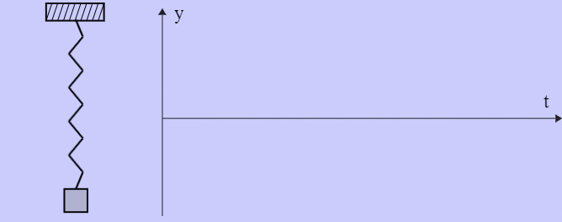
Damped Oscillation.
When an oscillating body is subjected to Frictional Force then its amplitude of oscillation decreases with time and eventually the body stops its motion.

Slide 3
Equation of Motion for Damped Oscillation.
In case of damped vibration, two types of forces acting on the vibrating body
One is restoring force which is proportional to the displacement
Another is damping force which is proportional to the velocity.

Slide 4
Mathematical Treatment of Damped Vibration.

Slide 5
Mathematical Treatment of Damped Vibration.
Case 1: Heavy damping or overdamped or dead beat motion

Slide 6
Mathematical Treatment of Damped Vibration.
Case 1: Heavy damping or overdamped or dead beat motion

Slide 7
Mathematical Treatment of Damped Vibration.
Case 2: Critical damping

Slide 8
Mathematical Treatment of Damped Vibration.
Case 3: Light damping or underdamped motion

Slide 9
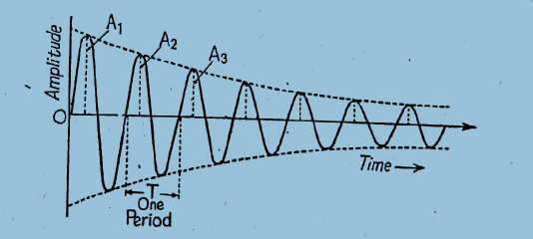
Case 3: Light damping or underdamped motion
The motion of a pendulam in air, discharge of a charged capacitor though an inductive coil of low inductance, oscillations of balastic galvanometer are the examples of light damped oscillatory motion

Slide 10
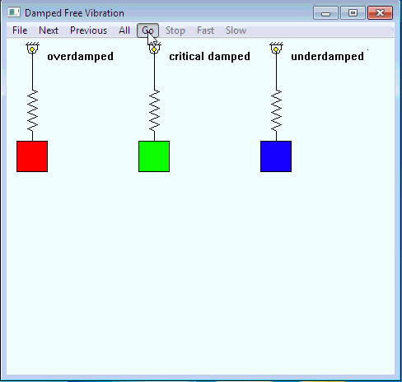

Slide 11
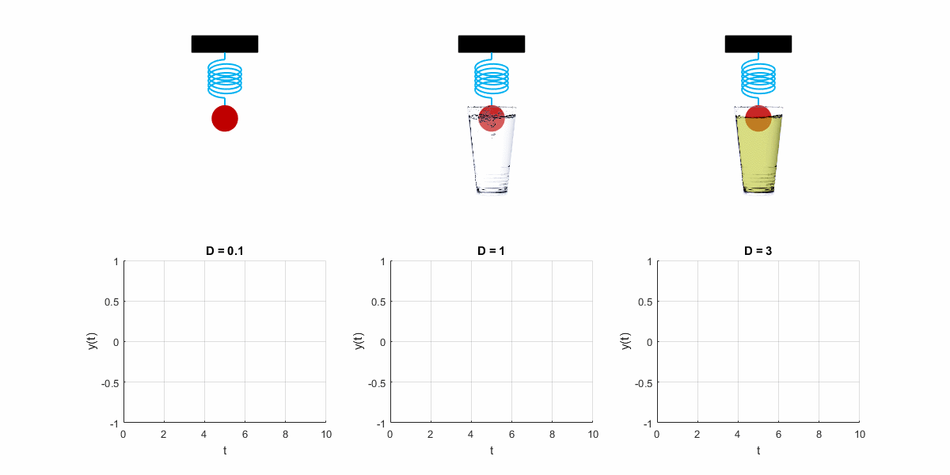

Slide 12
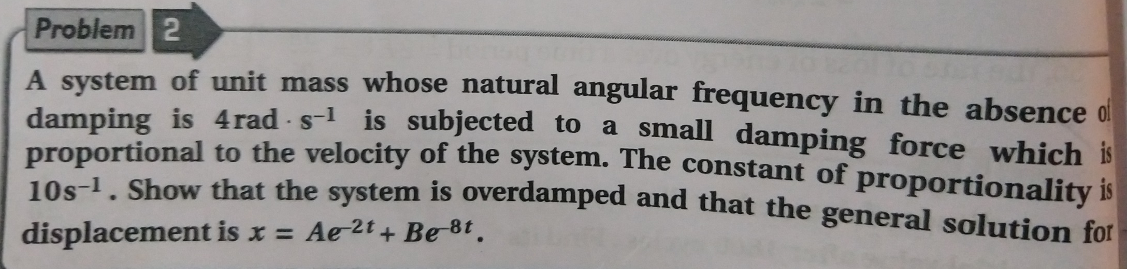

Slide 14
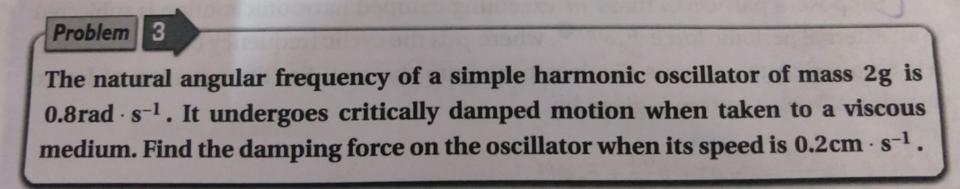

Slide 15
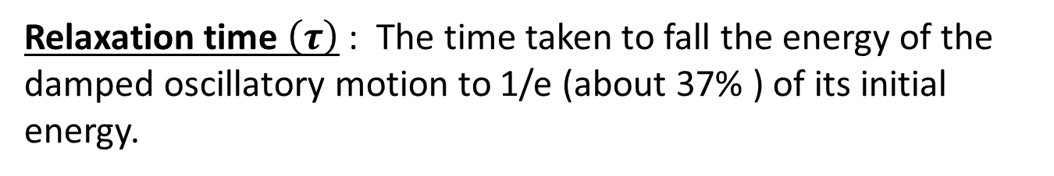
Attenuation Coefficients of a Vibrating System
Relaxation time $\left(τ\right)$ : The time taken to fall the energy of the damped oscillatory motion to 1/e (about 37% ) of its initial energy.

Slide 17
Time constant or Modulus of decay
This is the time in which the amplitude decreases to 1/e to its initial value.
Heavier the mass or smaller the damping time constant will be lager.
It gives a measure of how quickly the motion is damped out by retarding forces.

Slide 18
Logarithmic Decrement
It measures the rate at which the amplitude of Damped Oscillatory Motion dies away or falls off.
Logarithmic decrement is defined as the natural logarithm of two successive amplitudes of damped oscillations.

Slide 20
Quality Factor (Q)
The ratio of maximum value of restoring force to the maximum value of damping force is known as quality factor.
It is used to differentiate between light and heavy damping.
For less value of damping Q will be larger and thus quality will be better.

Slide 21
Quality Factor (Q)

Slide 23
Dissipation of power in Damped Harmonic motion

Slide 26
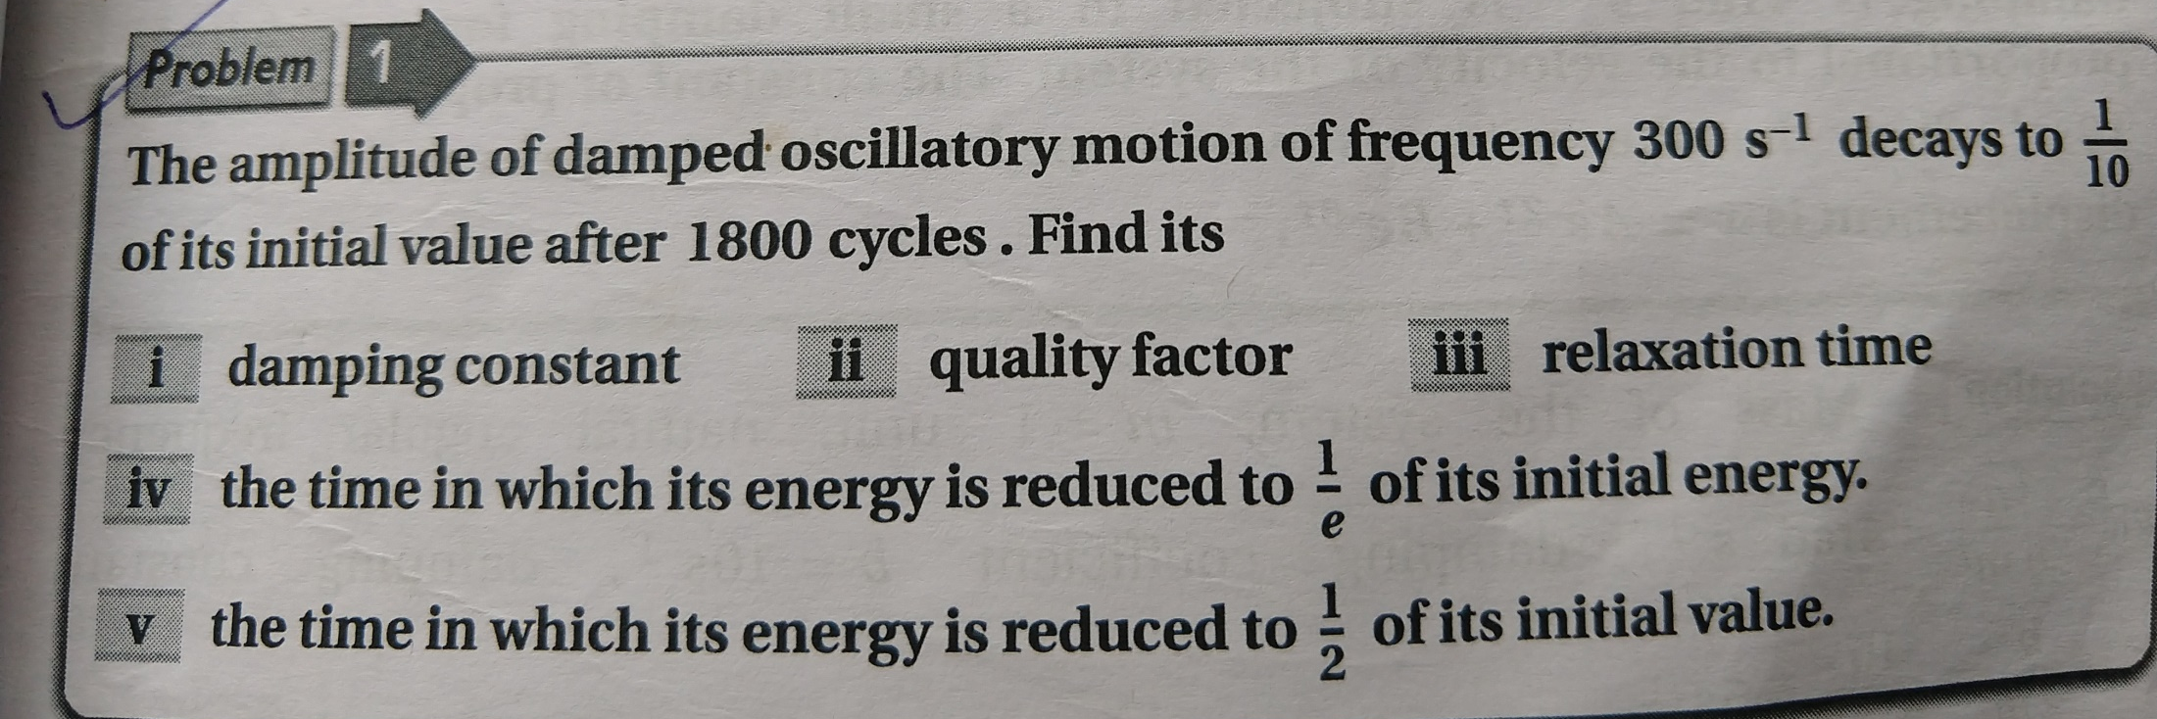

Slide 29
